Slide 1

Advanced Object-Oriented Design and Programming 2025
E-Commerce Application Development:
Emphasizing Object-Oriented Design, Design Patterns, and Secure Coding Practices
Submission Date: 26th Jan. 2026
University of Essex Online
Payman Ghorbani
January 2026

Slide 2
Project Overview
GitHub link: https://github.com/pg25304/ecommerce-capstone-project/tree/master
Scope:
Development of a scalable and secure e-commerce application.
Purpose:
Address challenges in user management, order processing, and inventory management through modular design and secure coding principles.

Slide 3
Problem Statement and Objectives
Problem Statement:
Managing user authentication, processing orders, and maintaining secured operations are essential for modern e-commerce systems.
Objectives:
Demonstrate Object-Oriented Design Principles for maintainability.
Apply Design Patterns to achieve flexibility and scalability.
Ensure secure coding practices like input validation, authentication, and exception handling.

Slide 4
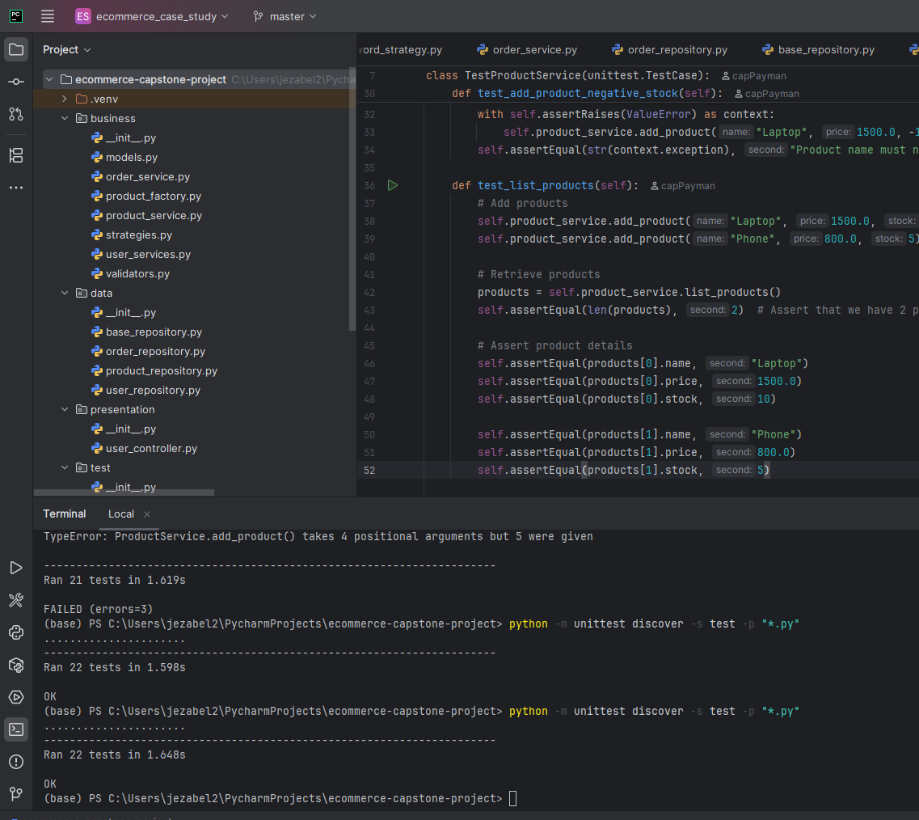
python -m unittest discover -s test -p "*.py" Before Starting
Testing the application (all test files)
Notes:
Sanitizing input in Python refers to the process of cleaning and validating user-provided data to prevent potential security vulnerabilities, such as SQL injection or cross-site scripting (XSS).

Slide 5
Key Features
1. User Management: User registration and login with password security.
2. Product management: Add, view, and manage products.
3. Order management: Place orders and track user order history.

Slide 6

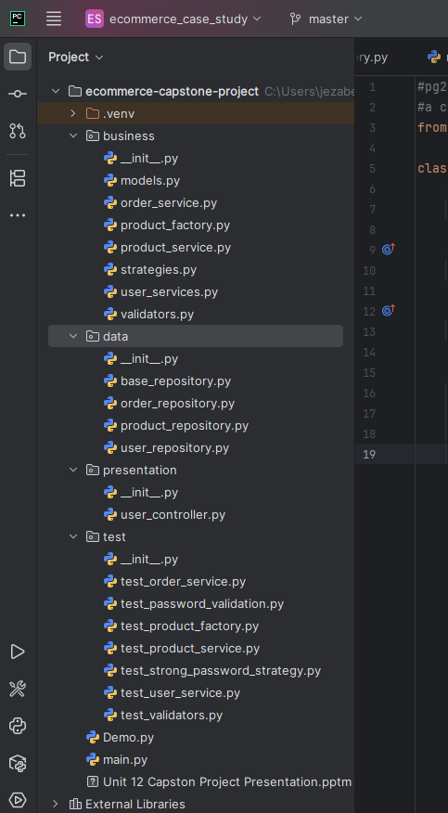
Design and System Architecture
(Monolithic layered App.)
Architectural Layers:
Presentation Layer: Interfaces with
the user (e.g., UserController).
Business Layer: Solves business logic
(e.g., UserService, OrderService).
Data Layer: Manages storage
and retrieval (UserRepository).
Dependency’s flow:
Presentation ->Business ->Data

Slide 7
Object-Oriented Design Principles I
Encapsulation:
  Each class encapsulates its specific responsibilities, such as UserService handling user-related operations and OrderService managing order logic
Polymorphism:
  when multiple methods with the same name can handle different parameters. i.e. overloading save() and find() methods with different parameters in product_repository.py and order_repository.py
Notes:
Polymorphism is achieved through method overriding (when a subclass provides a different implementation of a method) or method overloading (when multiple methods with the same name can handle different parameters).

Slide 8
Object-Oriented Design Principles II
  Inheritance:
  BaseRepository.py is a parent class extended by repositories (UserRepository, OrderRepository).
Abstraction:
  Layers isolate specific concerns, such as data access, UI handling, and business logic.
  Making it easier to understand, maintain, and modify individual components without affecting the entire system.

Slide 9
Application of Design Patterns – Factory Method
Implementation: product_factory.py
Abstract Product: Product class with a get_details() method.
Concrete Products: DigitalProduct and PhysicalProduct inherit from Product.
Factory: A ProductFactory with a method to create objects based on input type (e.g., "digital", "physical").
Purpose: Simplify object creation by encapsulating logic; enhances flexibility and scalability.
Testing: Terminal:
Python main.py -> test the code (Factory method) from terminal
python -m unittest discover -s test -> verify the implementation.

Slide 10
Application of Design Patterns II
Structural Patterns:
Dependency Injection: Example: Passing repositories and validation strategies into classes like UserService (user_services.py).
Import from validators.py and strategies.py
Behavioural Patterns:
Strategy Pattern: Provides flexibility for password validation (e.g., BasicPasswordValidationStrategy vs StrongPasswordValidationStrategy) in strategies.py
Notes:
Structural Patterns
Structural patterns deal with class composition and object relationships to create flexible and efficient design.

Slide 11
Secure Coding Practices
Input Validation: validators.py
validate_email() and validate_password() prevent invalid data entry.
sanitize_input() avoids injection attacks.
Authentication:
Secure password hashing with bcrypt (user_service.py)
Exception Handling:
Comprehensive error handling ensures fault tolerance (validators.py).
Notes:
Sanitizing input in Python refers to the process of cleaning and validating user-provided data to prevent potential security vulnerabilities, such as SQL injection or cross-site scripting (XSS).

Slide 12
Application Workflow (High-Level)
Overview:
Step 1: User Registration
Step 2: User Login
Step 3: Add Products to Store
Step 4: View Available Products
Step 5: Place an Order
Step 6: View User's Order History

Slide 13
1. User Management
Users can register by providing:
- A unique `user_id`
- A valid email address
- A strong password- Passwords are encrypted using `bcrypt` for secure storage.
- Users can log in using their credentials.

Slide 14
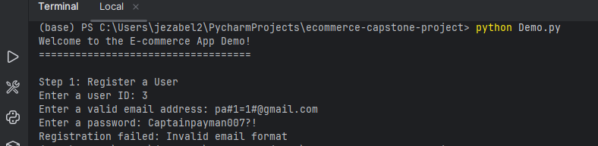
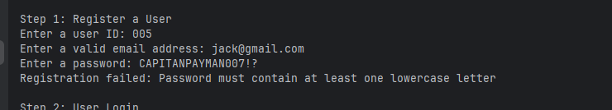
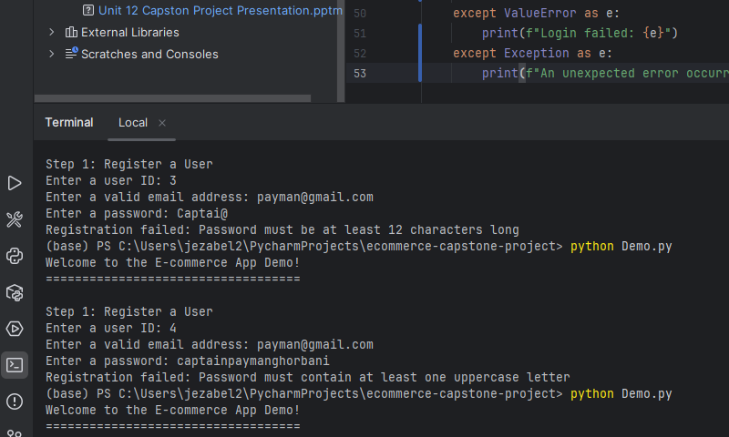
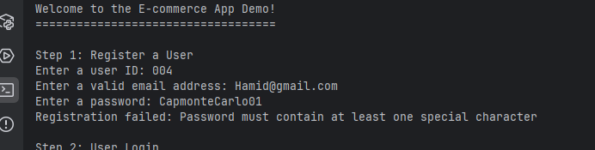
1. User Management - Registration
Open Demo.py
Open Terminal and type python Demo.py
Failed Registration:
Password: Less than 12 Characters,
All lower case, without a special charact,
All upper case
Invalid email format

Slide 15
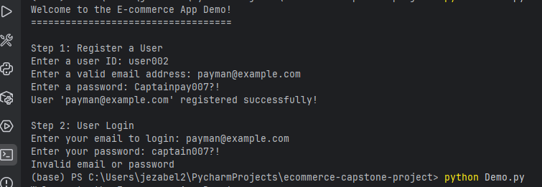
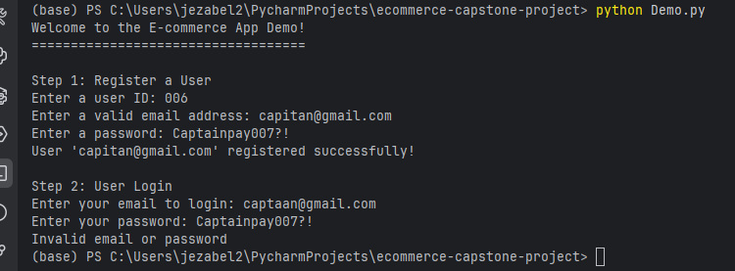
2. User Management - User Login
Successful Registration, and failed login (wrong password)
Successful registration and failed login (wrong email address)

Slide 16

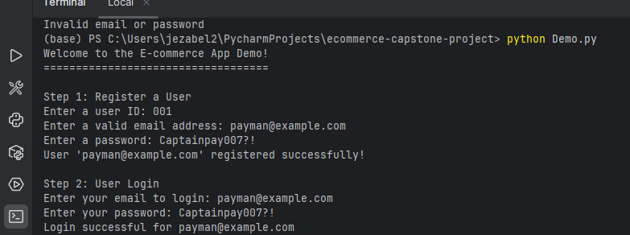



1 & 2. User Registration & login: working
Successful registration and login

Slide 17
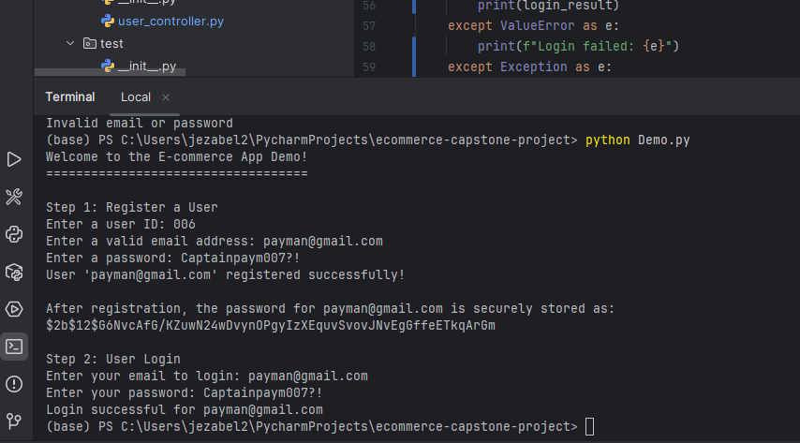
Security Feature - Hashing & storing password
During the login process, bcrypt will verify the hashed password with the user's input and authenticate them if they match.

Slide 18
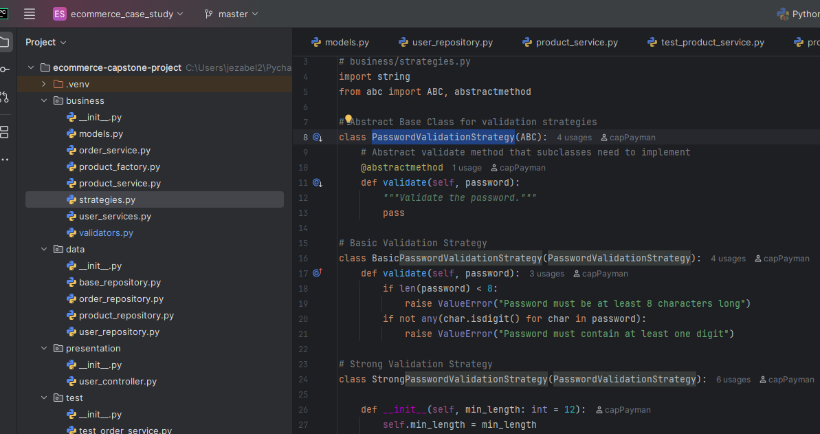
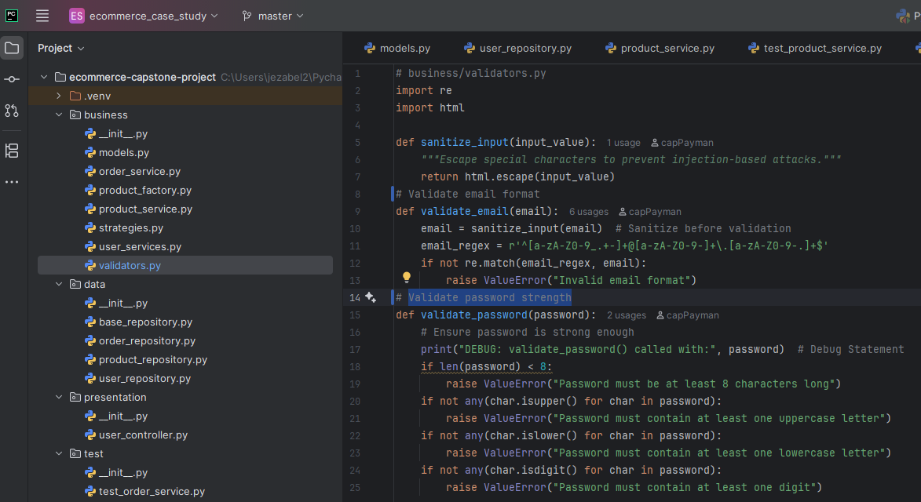
User’s input, email, and password validation
"Password validation in our app is split into strategies.py (to define flexible validation policies) and validators.py (to implement specific validation logic) for modular and reusable code.“

Slide 19
Product Management
All the users can:
- Add new products to the store with:
Name Price Stock quantity View all available products.

Slide 20
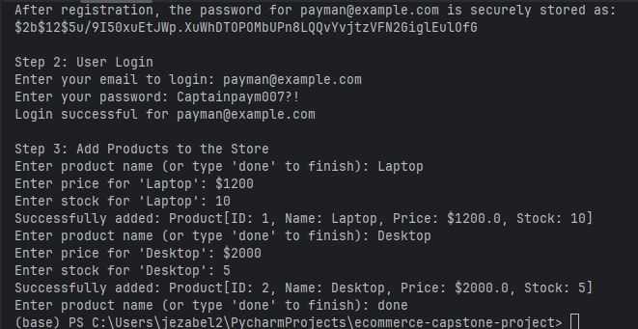
3 & 4. Product Management – Addition & View Products
Product_id will be
generated automatically

Slide 21
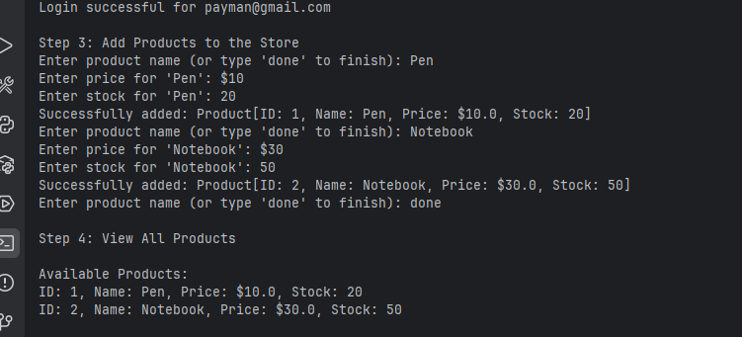
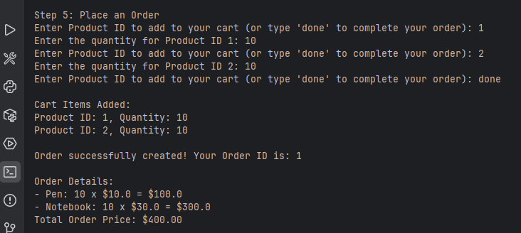
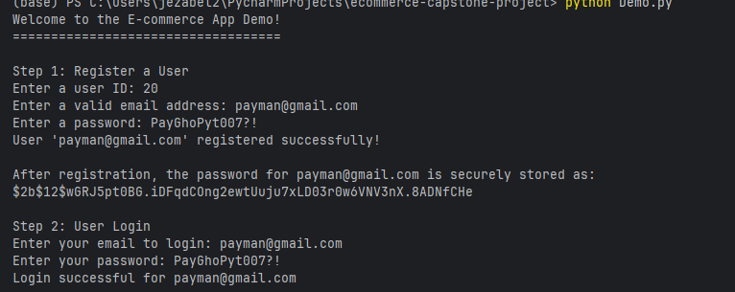
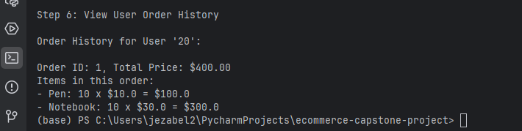
Step 1 to 6: Registration, Login, Add Products, View all products, Place an order, View User Order History

Slide 22
Real-World Challenges and Solutions
Challenge 1: Dynamic requirements for password validation.
Solution: Implemented Strategy Pattern for validation flexibility (strategies.py).
Challenge 2: Complex repository interactions.
Solution: Used BaseRepository for consistency and reusability (base_repository.py).
Challenge 3: Mitigation of common security risks.
Solution: Input sanitization and secure authentication via bcrypt (user_service.py and validators.py).
Notes:
Sanitizing input in Python refers to the process of cleaning and validating user-provided data to prevent potential security vulnerabilities, such as SQL injection or cross-site scripting (XSS).

Slide 23
Key Learnings
The importance of maintaining modular code for scalability.
Application of object-oriented principles in real-world projects.
Benefits of secure programming practices in minimizing vulnerabilities.
Notes:
Sanitizing input in Python refers to the process of cleaning and validating user-provided data to prevent potential security vulnerabilities, such as SQL injection or cross-site scripting (XSS).

Slide 24
Improvement
1 - Improvement: Using Argon2 rather than bcrypt
Reasons:
It is memory-hard (resistant to GPU-based attacks).
Slows down brute-force, DDoS, attacks efficiently.
2 - To catch the ValueError exception messages in my code and handle it gracefully, using a try...except block while running test files within test folder
3 – Imbedding Administration

Slide 25
Questions and Reflections
Open to questions about design, implementation, or future improvements.
Reflection: This project showcases the synergy of software engineering principles and real-world problem-solving.
Notes:
Sanitizing input in Python refers to the process of cleaning and validating user-provided data to prevent potential security vulnerabilities, such as SQL injection or cross-site scripting (XSS).

